Slide 1
Database Restructuring Helper
Akash Deep - 19JE0081
Sonali Verma -19JE0814

Slide 2
Problem Statement
Using a codebase and a DB - Walk through the codebase to find instances of DB access.
Find instances of joins
Verify if the joins are reflected in the DB too via constraints.
Simplify Joins - If there is a join involving 3 or more tables, provide equivalent code that is easier to understand.

Slide 3
References
https://www.w3schools.com/java/
How to merge xml files.
Different ways in which a join can be used.
https://dev.mysql.com/doc/refman/5.7/en/rewriting-subqueries.html

Slide 4
Workflow
Having basic knowledge on file parsing
Find all db instances and store them in separate xml file
Research over finding the instances of joins
Code to identify the joins instances.
Research over simplifying the joins
Check for the number of tables involved in joins and write equivalent code.

Slide 5
Progress of the Project
Found the db instances in the directory and store them in a xml file.
Identified the different scenarios which can be considered as a join query.
Wrote the code to find the instances of joins for the above mentioned scenarios.

Slide 6
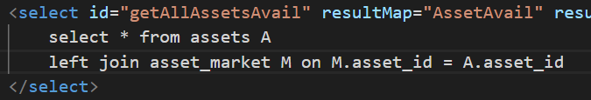
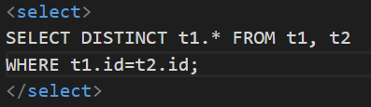
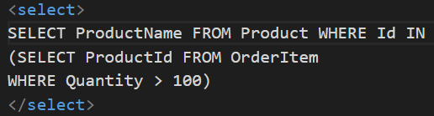
Instances of Joins
Instances of Joins that we have considered:
A select statement having Join word.
Without using join word - A select statement having more than one table. Table name as alias case is also handled.

Slide 7
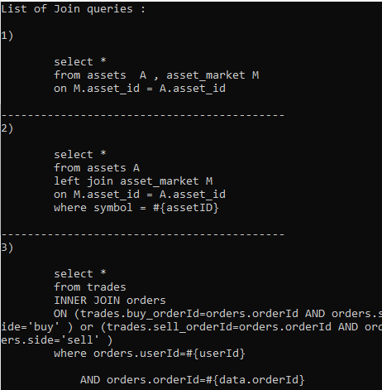
Result Image

Slide 8
Going Forward
Planning and milestones for next semester
Identify select statements that might be added to the result as a part of join instances
Verify if the joins are reflected in the DB via constraints.
Simplify Joins - If there is a join involving 3 or more tables, provide equivalent code.

Slide 9


